Slide 1
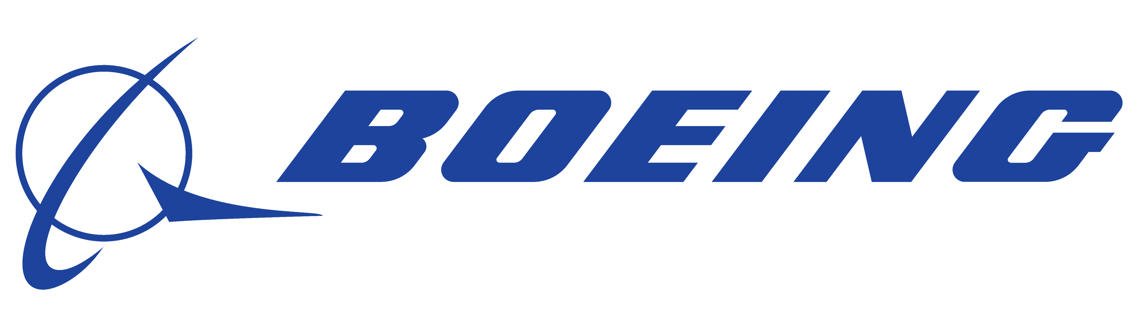




In Pursuit of Safety: Strengthening the Governance and Controls of Boeing Inc.
Ray Chang
Will Dannacher
Akshitha Shankar
Vahin Vuppalanchi

Slide 2

Boeing currently stands at a pivotal juncture in their history
Previously
What measures should Boeing implement to enhance safety, rebuild public confidence, and prevent a recurrence of such incidents?
Boeing is a prominent aerospace company known for its high-quality products. The Boeing 737 MAX, part of the fourth generation of the Boeing 737 family, aimed to improve fuel efficiency and extend the range compared to its predecessors.
Overcoming
Challenges
Disaster Unfolds
On October 29, 2018, Lion Air Flight 610, a Boeing 737 MAX 8 en route from Jakarta to Pangkal Pinang, experienced technical issues soon after departing Soekarno-Hatta International Airport. The plane subsequently went into a steep dive and crashed into the Java Sea about 13 minutes after takeoff, prompting an inquiry into IT Governance and Control procedures.

Slide 3
Boeing will transform into a safety prioritized culture to better organize their change management
Current State
Existing 737 NG Aircraft
System Alterations
Executive
Approval: Safety Negligence
Continue Normal Operations
Legend
Change Management Missing
Normal
Root Cause
Future State
Future State
Change Management Procedure
Review Changes with Safety Committee
Enforce New Safety Control: Redundancy, Testing & Training
Safety Prioritized Culture
With proper governance & control in place, alongside with safety prioritized culture, Boeing could avoid a second crash and gain back the reputation

Slide 4
We urge an organizational transformation in governance,
controls, and a cultural shift towards safety
GOVERNANCE
CONTROLS
CULTURAL SHIFT
Restructuring the leadership and decision-making framework within Boeing
Clarify responsibilities and ensure that safety-related decisions are made with appropriate input and oversight from relevant stakeholders.
Enhancing controls to implement robust systems and processes that monitor, manage, and mitigate risks associated with aircraft design changes and practices around safety regulations and policies.
Instill a mindset and set of organizational behaviors that prioritize safety
Foster a culture of transparency, accountability, and continuous improvement in safety practices.

Slide 5



Boeing should establish a safety committee to oversee safety across all operations
The primary objective is to ensure any system design change, updated safety measures, policies has been carefully reviewed and correctly approved to make sure safety controls in place and minimizing risks associated with aircraft manufacturing and operations
Roles
Responsibility
Authority
Appointing a Chief Safety Officer who will be held accountable for all safety-related matters
Chief Engineer Officer, Chief Supply Chain Operations, Chief Quality Operations, and Chief Compliance Officer be responsible
Chief Legal Officer, Subject Matter will be consulted
Working Group Representatives
Review and approve safety protocols, standards and procedures
Review system/design changes from the perspective of safety
Monitor safety compliance and conduct regular safety audits
Responding to safety incident reports and concerns
Meet bi-weekly or more frequently if urgent safety matters arise
Authority spans across all departments and levels of the organization
Hold the final authority on approving safety protocols, guidelines, and recommendations.
Enforce safety regulations and policies.
Authority to allocate budget and resources for safety initiatives.

Slide 6
Boeing will develop set standards for each of their controls to detect and prevent flaws in design
Internal Testing
Training Controls
External Security Compliance
Process Change Management
All 737 MAXs should have multiple simultaneous AoA sensors
Weekly checks and standards to ensure equipment meets criteria
Develop 1-2 edge cases per major upgrade to account for unlikely scenarios
Enforce training for all 737 MAX pilots twice a month
Simulate emergency situations monthly and teach pilots how to manage these situations effectively
Test pilots on system malfunctions monthly to ensure adequate understanding and competencies
Set weekly meetings with the FAA while developing changes to the 737 MAX
All project design phases need to incorporate regulators
Reach out to external bodies and work to have an independent audit every two quarters
Incorporate a thorough step-by-step process for any changes made to the system
Compare each modification to a set safety and regulations document
When developing a modification, consider and account for several possible risks and mitigations
Set Standards Will Provide Boeing With Clear Metrics and KPIs

Slide 7





A cultural shift towards prioritizing safety and increased engineering standards is imperative to regain stakeholder trust
Leadership Involvement is pivotal in this process
Communication
Safety Promotion
Maintain open lines of communication regarding the causes of the crash, the steps taken to prevent future occurrences, and the progress on safety measures.
Regularly disseminate information about safety procedures, learning from past mistakes, and industry best practices.
Integrate safety as a non-negotiable core value within the company’s mission and operational principles.
Implement robust safety training programs for all employees, tailored to their roles and responsibilities
Emphasize the importance of safety in daily operations through continuous, comprehensive safety tests for all employees
Employees at all levels are held accountable for adhering to and promoting safety standards.

Slide 8
Measuring the performance of our initiatives is critical to ensuring continuous adherence to the recommended procedures
Metric Calculation
Description
Y1.5 Success
Safety Performance
Incidents/
Accidents Rate
# Incident / Total flights for the year
Track incidents reported by airlines.
Decrease to
0%
Decrease to
0%
Defections such as sensor failure, system malfunctioning
Defects Rate
Defected parts/Total Parts
System Testing Accuracy
Accurate outcome/Total Testing
Validating the system against requirements
Increase to
90%
Compliance
Audits Outcome
# of findings for incompliance
Tracking the number and severity of findings
Decrease by 50%
Supplier Safety Compliance
# of findings for incompliance
Measure vendor compliance
Decrease by
15%
Training
Training Completion Rate
Completed Training/Total Training Required
Ensure pilots are properly trained for new system
Increase to 100%
Employee Safety Test Accuracy
Average score for the safety training programs’ written test
Measure organization wide safety awareness
Reach to 85%

Slide 9
A two-year cultural transformation at Boeing is necessary to integrate the governance and control procedures
Tasks / Activities | Q1 | Q2 | Q3 | Q4 | Q5 & on
Assessment of Current Regulatory Compliance
Appointment of Chief Safety Officer
Formation of Safety Committee
Develop Roadmap for Internal Controls
Pilot Safety Education
Regular Safety Examinations
Ongoing System Monitoring
Testing Phase
Ongoing External Audits

Slide 10
Boeing can prevent significant financial distress by investing in this strategy
Indirect Costs
Norwegian Air Contract Fallout | $11.5B
Airline Compensation | $5B
$16.5B
Costs of our Recommendation | Cost
Grounding Opportunity Cost (1 Year) | $900M Per Quarter
Annual Salaries of Committee Members | $500K (Recurring)
Testing & Training Cost | $1M Monthly (Recurring)
$3.6B
Direct Costs
Customer Compensation | $8.6B
Extra Production Costs | $5B
Increased Costs | $6.3B
Victim Compensation | $100M
$20B
CSO Certification Cost | $2.5K (One-Time Fee)

Slide 11
Boeing will be able to mitigate any possible risks
Organizational Resistance to Change
Ineffective Governing Committee
Over-reliance on FAA Audits
Impact
Impact
Impact
Likelihood
Likelihood
Likelihood
Extensive change management efforts, including clear communication, training, and involvement of employees in the process.
Involve the employees, ensuring the training and dialogue is relevant to their roles and responsibilities
Ensure that the committee is composed of individuals with diverse expertise and perspectives
Governance Charter to act as a guide to help make decisions and inform accountability
Implement a robust internal safety management system (SMS) that goes beyond regulatory requirements and incorporates proactive risk assessment and mitigation measures
Encourage employees to stay informed about industry trends and best practices.

Slide 12
Boeing will transform into a safety-prioritized culture to better organize their change management
Safety is Not a Priority
Board Made Executive Decision
Current State
Existing 737 NG
Alterations Made
Continue Normal Operations
Change Management Procedures Missing
Future State
Existing 737 NG
Alterations Made
Continue Normal Operations
Legend
Internal Testing and Controls
Knowledge Sharing: Include in Manual
Normal
Root Cause
Future State
Review with Safety Committee
No Issues Found
Pilot Training
Safety Prioritized Culture
Issues Found

Slide 13
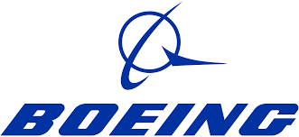



Charting a Safer Course
GOVERNANCE
CULTURE
Cultivate a culture where safety is ingrained in every action and every decision. We all share in the duty to protect each other and our customers.
Reinforce a governance structure that prioritizes safety over all else, ensuring decisions are made with utmost due diligence
INTERNAL CONTROLS
Detect and prevent safety risks by carefully scrutinizing every process and process change
We understand that change can be challenging, but we are committed to supporting every team member through this transition. Together, we will build a safer, more resilient organization.
13

Slide 14
APPENDIX

Slide 15
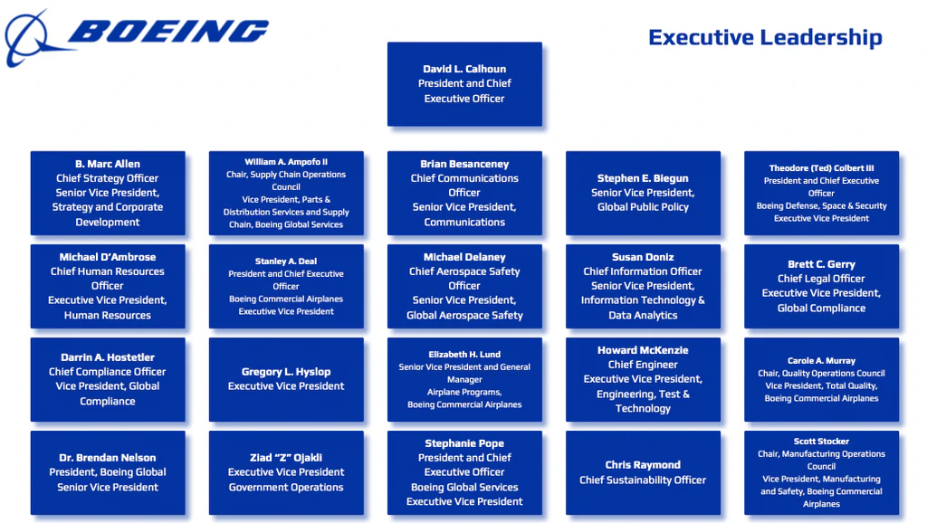
Target State: Organizational Chart
Safety Committee
Chief Safety Officer

Slide 16
Safety Committee RACI Matrix
 | CEO | Chief Safety Officer | Chief Legal Officer | Quality Operations Chair | Chief Engineer | Chief Compliance Officer | Subject Matter Experts | Working Group
Review and approve safety protocols, guidelines | I | A | C | R | R | R | C | R
Review system/design changes from the perspective of safety | I | A/R | C | I | R | R | C | R
Monitor compliance and conducting regular safety audits | I | R | C | I | R | A/R | C | R
Respond to safety incident reports and concerns | I | A | C | R | R | R | C | R
Report safety findings to CEO for situational awareness | I | A/R | C | R | R | R | C | R

Slide 17
Detailed Explanation of IT Controls
Sensor Redundancy
Simulator Training
Multiple AoA sensors to prevent a single failure from causing a safety issue
Helps pilots become proficient in managing situations related to MCAS and other systems
Quality Assurance
Emergency Situations
Checks and standards, including inspection, testing, and verification to ensure equipment meets criteria
Pilots must be trained to handle these situations in a safe and effective manner
Edge Cases and Failure Modes
System Malfunctions
Testing unlikely scenarios is essential to uncover potential vulnerabilities that may not be apparent traditionally
Pilots must be trained to diagnose and respond to these effectively

Slide 18
Detailed Explanation of IT Controls
Collaborate Closely with FAA
Change Management System
Makes sure that regulators have a more active role in overseeing the safety regulation process
Well-defined process for evaluating and implementing changes to the aircraft’s systems
Involve Regulators in Design Phase
Modification Review & Approval
Ensures safety standards are met from the beginning and prevents issues during certification
Ensures that any modifications meet safety and regulatory requirements.
Regular Audits by External Bodies
Assess Impact on Safety
Independent organizations conduct periodic reviews to ensure ongoing safety and regulatory compliance
Considers potential risks and hazards and attempts to mitigate any effects on safety
18

Slide 19
Details on Financial Analysis
Our Recommendation
The prospect of another threat
Sensor Cost | $0 - Boeing manufactures the sensors and they are already built into the 737 Max
Simulator Training - Yearly | $5 billion per year that would occur whether or not the planes are grounded
High-End CSO Salary - Yearly | $80 thousand is the high end of CSO salaries
CSO Certification – One-Time | CSO certification cost is $2.5 thousand
Grounding Cost - Quarterly | Boeing incurs a cost of $900 million per quarter that they cannot fly the 737 Max
Customer Compensation – One-Time | Customers getting money back from flights total $8.6 billion
Increased Costs – One-Time | Boeing incurred a $6.3 billion for disaster recovery following the crash
Jet Storage – Yearly/Quarterly | Almost 12 thousand 737 Max Planes needed to be stored for a year, totaling $600 million in costs
Production Costs – One-Time | Disruption of the production chain incurred $5 billion according to Boeing's report
Victim Compensation – One-Time | Boeing paid a total of $100 million to families of the victims in the crash
Norwegian Air Contract – One-Time | Contract for 97 aircrafts fell through following the crash, selling at $55 million on average each
Airline Compensation – One-Time | Airline contracts have clauses built in for customer ticket cancellation and switching costs, totaling $5 billion incurred by Boeing

Slide 20
Root Cause Analysis
Why?
Why?
Why?
Why?
Sensor Inaccuracy
Single AOA & No Redundancy
Additional AOAs are Expensive
Board Prioritized Cost Savings
Safety is Not Considered a Critical Factor
Change Management Procedures Missing
Why?
Insufficient Pilot Training
Why?
Insufficient System Testing
Why?
Insufficient Internal Audit

Slide 21
Additional Risks and Mitigations
RISK
SEVERITY
MITIGATION
Inadequate Testing Protocols
Conduct thorough risk assessments to identify potential failure points and design tests to address these areas specifically
Involving diverse teams to develop a structured approach to identify and include edge cases
The testing protocols may not cover all critical scenarios or may fail to detect potential issues, leaving vulnerabilities in the safety system.
The testing protocols may not cover all critical scenarios or may fail to detect potential issues, leaving vulnerabilities in the safety system.
Impact
Likelihood
Public Perception
Implement a robust communication strategy demonstrating Boeing's commitment to safety, transparency, and continuous improvement.
Engage with stakeholders, including customers, regulators, and the public, to rebuild trust.
Public perception and stakeholder confidence in Boeing could be fragile due to the recent tragedy. The successful implementation of safety initiatives will be closely scrutinized.
Impact
Likelihood
Ineffective Trainings
Regularly assess the effectiveness of training through feedback loops and practical evaluations.
Synergize with the FAA to check the training procedures.
Provide additional resources and support for employees who may require extra assistance.
Training programs may not sufficiently equip employees with the necessary skills and knowledge to prioritize safety.
Impact
Likelihood

Slide 22
Bibliography
Aviation Security –
https://www.iata.org/en/publications/newsletters/iata-knowledge-hub/what-you-need-to-know-about-aviation-security/
KPIs –
https://www.isarsoft.com/article/performance-measurement-in-airports-top-10-kpis-for-every-airport
Financial Analysis –
https://www.cnn.com/2020/11/17/business/boeing-737-max-grounding-cost/index.html
Root Cause Analysis –
https://embeddedartistry.com/wp-content/uploads/2019/09/the-boeing-737-max-saga-lessons-for-software-organizations.pdf
Research –
https://www.cnn.com/2019/12/12/business/boeing-737-max-southwest-employees/index.html
Cultural Shift –
https://www.faasafety.gov/files/gslac/library/documents/2013/Mar/75455/AgSafety_brochure.pdf

